Slide 1


Slide 2
Database lab Report
Project: SeedSchool
Team member: Phạm Hải Đăng – 20194736
Hoàng Thanh Lâm – 20194786
Phạm Thành Biên – 20194731
Hoàng Quang Mạnh – 20194795

Slide 3
Overview of project
The following proposed system is intended for the reference staff of SeedSchool and also kid’s parents. This website is an education management system, which provides an useful management tool for administrator. This web-base application is designed as the requirement from principle and vice-principle of SeedSchool kindergarten.

Slide 4
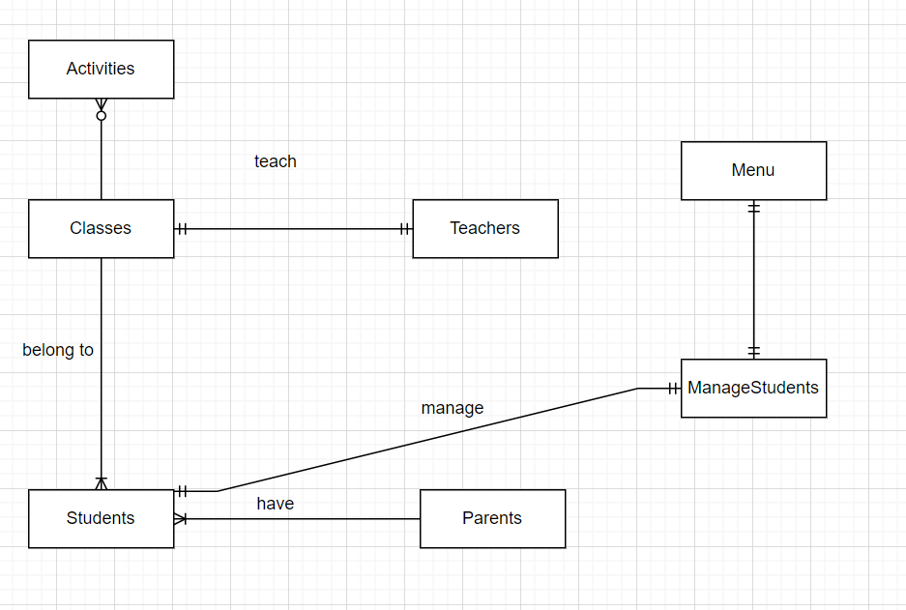
Database design

Slide 5
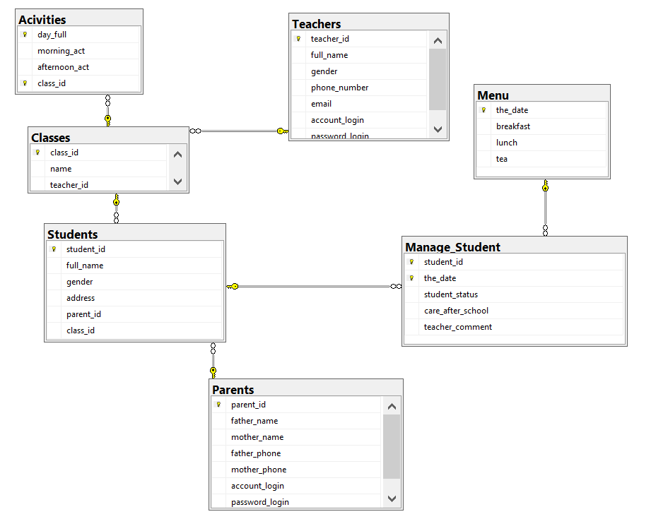
Database design

Slide 6
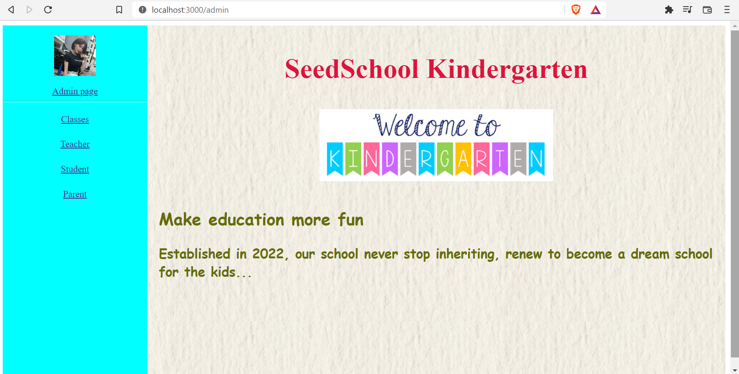
Website demo

Slide 7
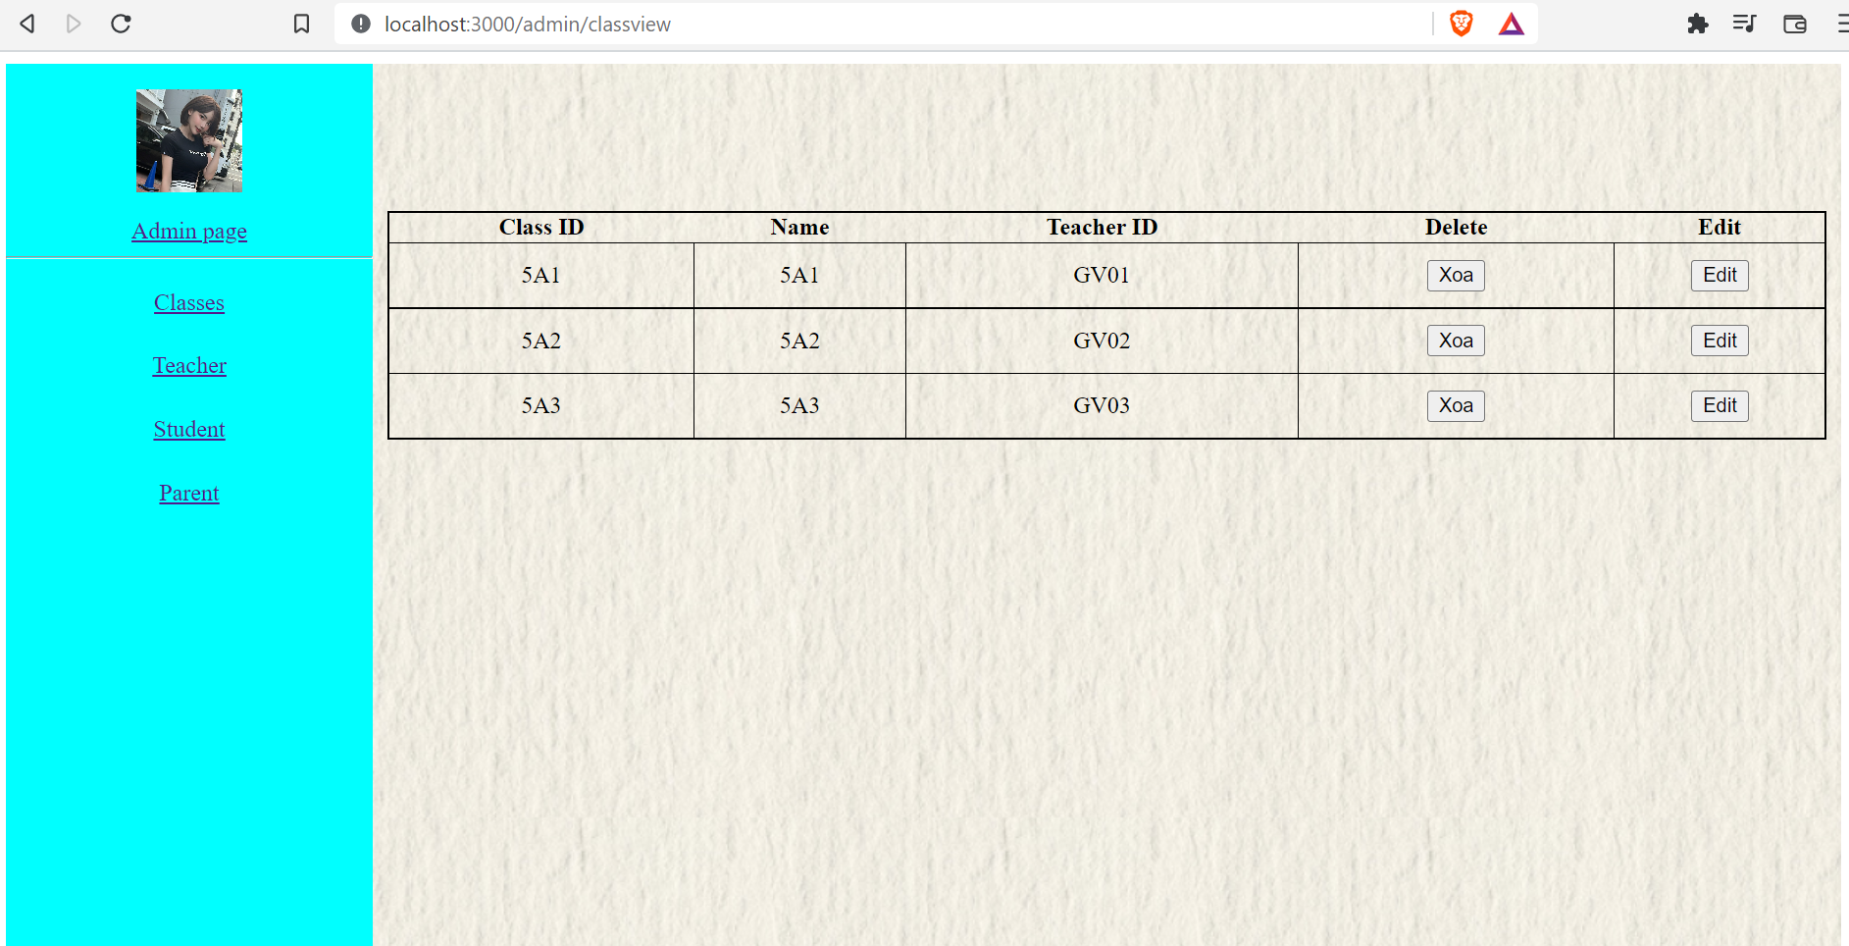
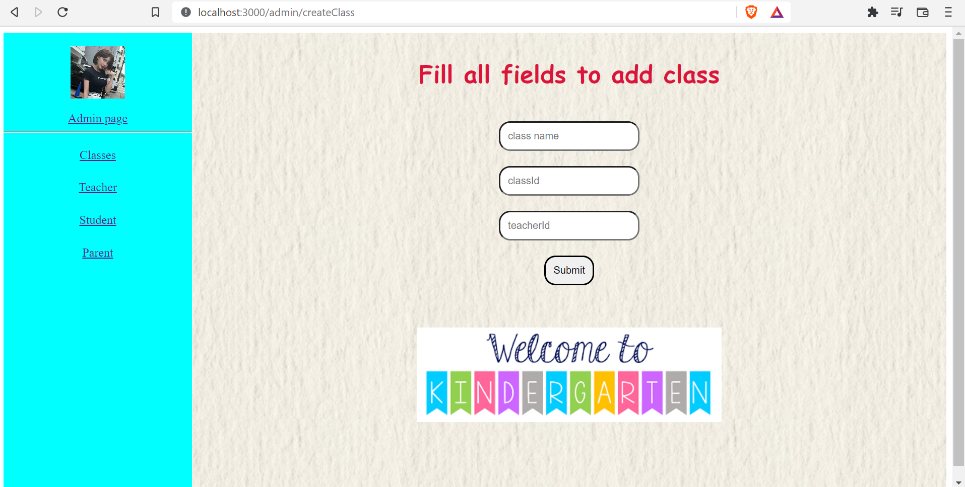
Class management

Slide 8
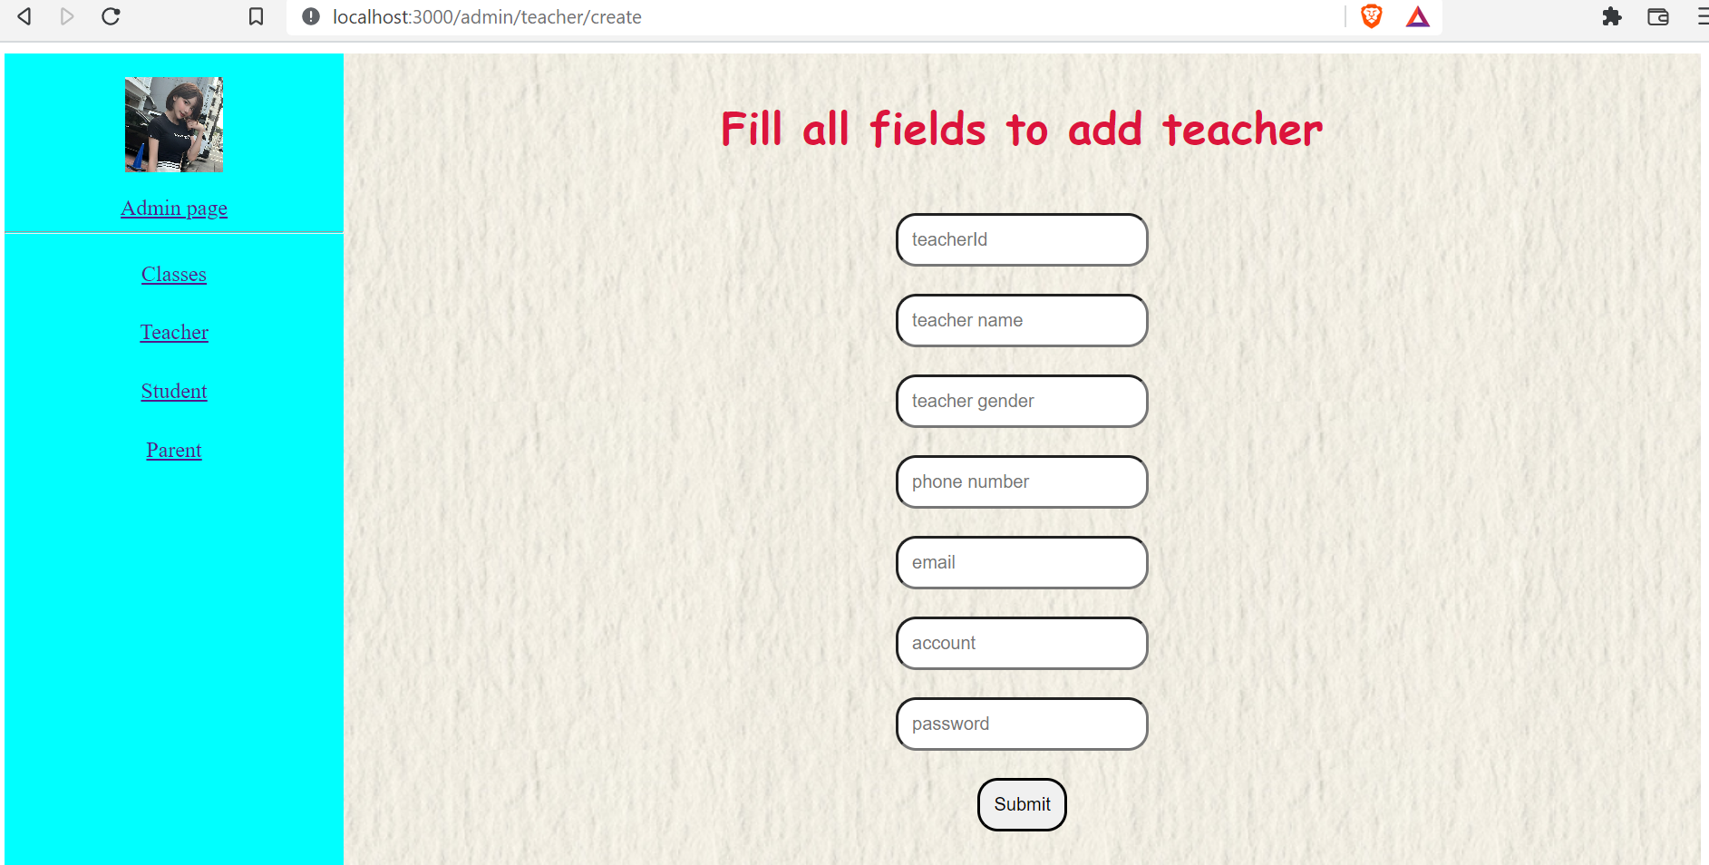
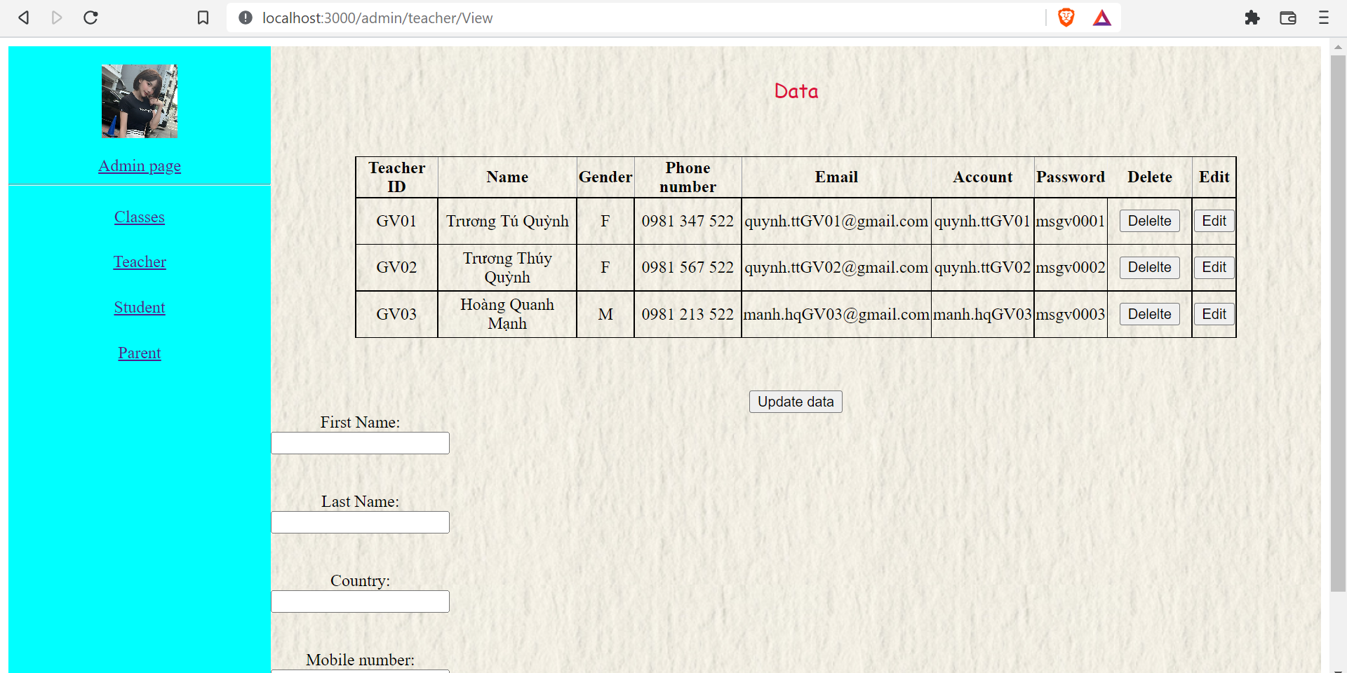
Teacher management

Slide 9
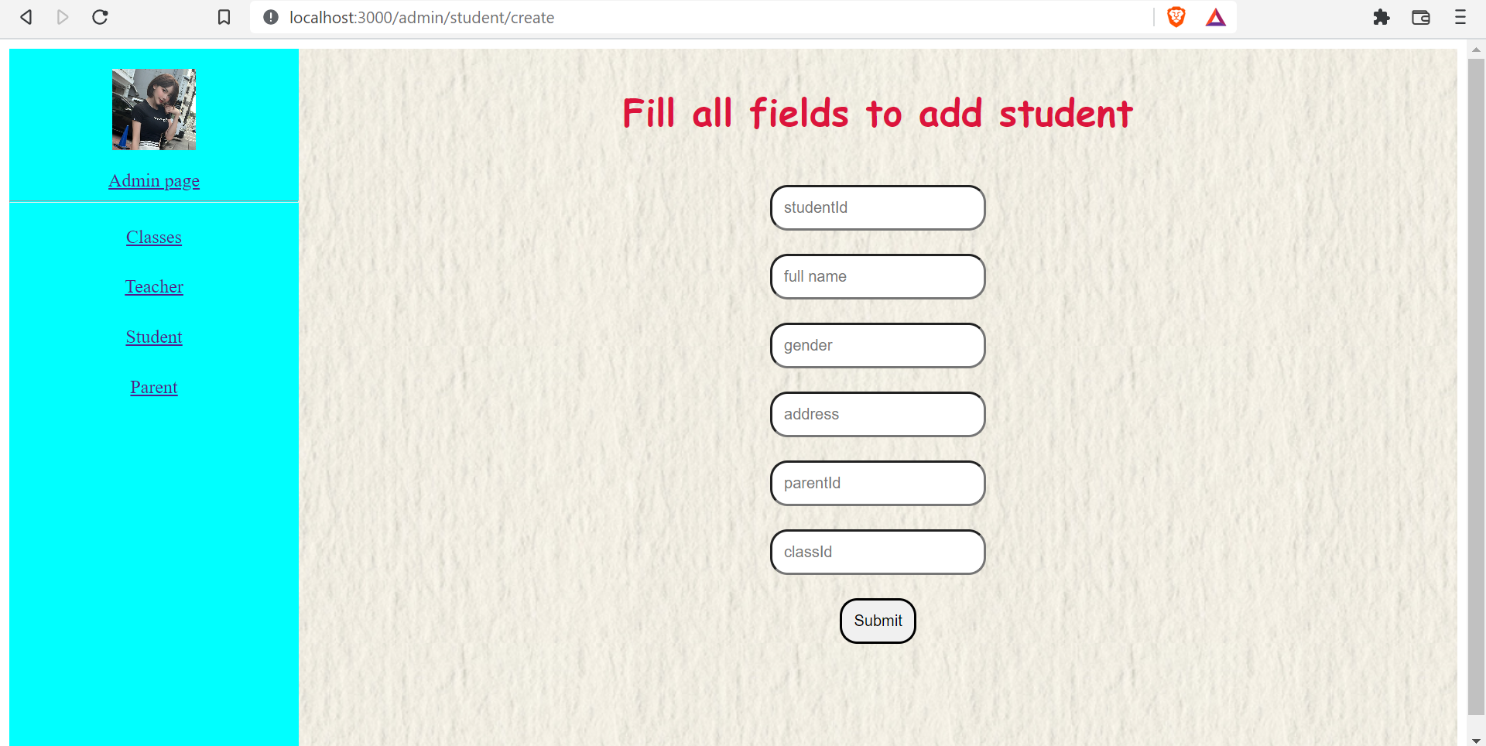
Student management

Slide 10
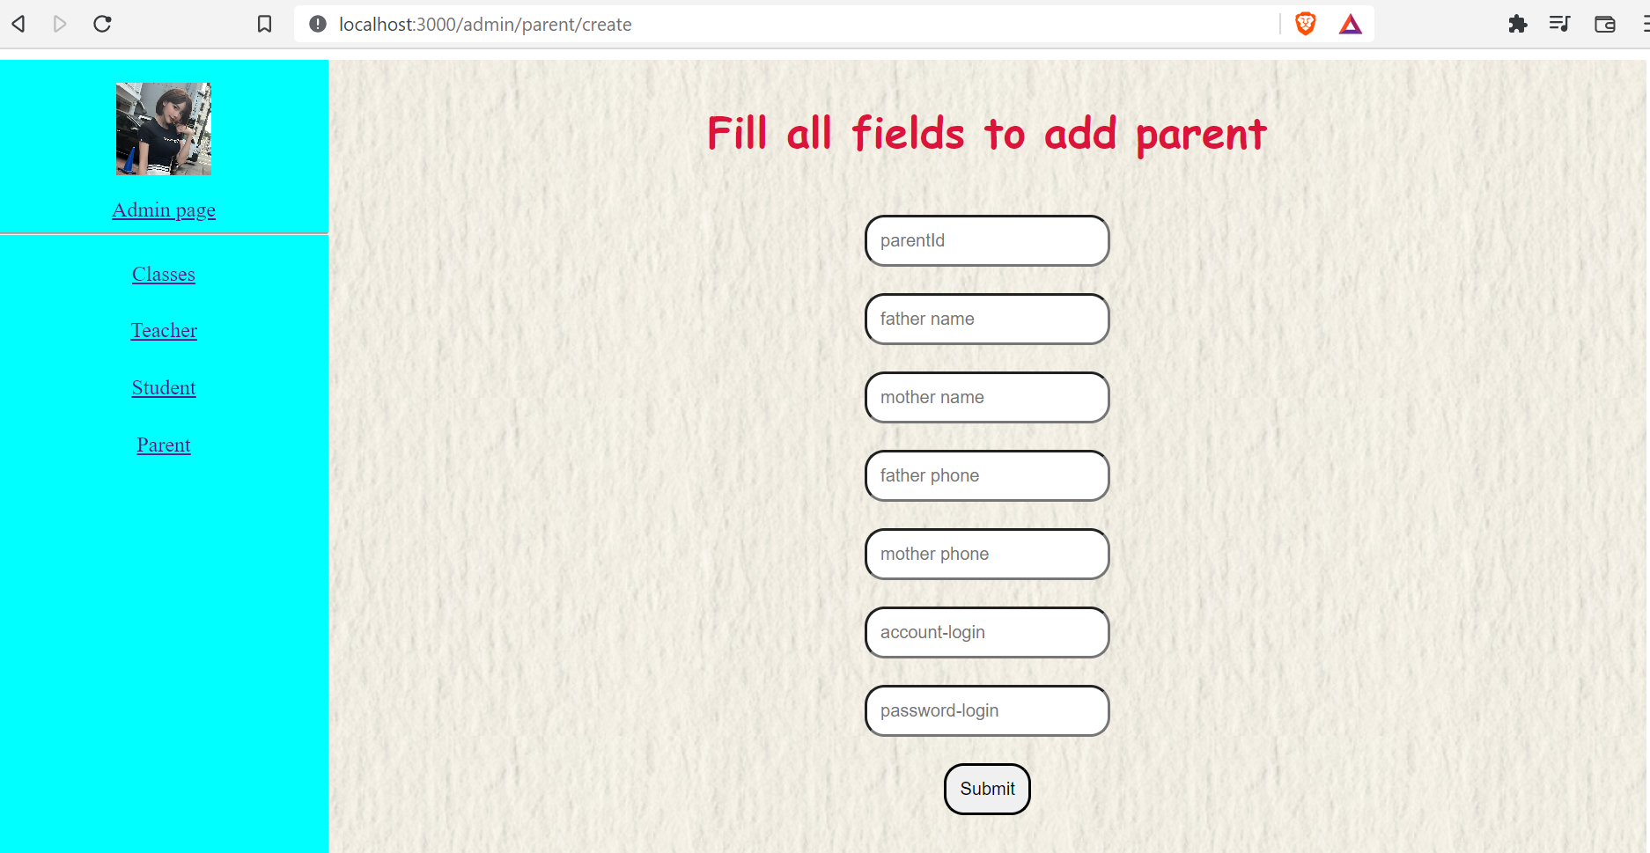
Parent management

Slide 11
Demo project

